Slide 1


Bank Loan of Customers Analysis

Slide 2
Dataset Introduction
Domain : Finance
Project : Bank loan of customers
Datasets : Finance_1.xlsx & Finance_2.xlsx
Dataset Type : Excel Data Dataset Size:
Each Excel file has 39k+ records

Slide 3
Project Objective
The project aim to analyze the Finance dataset of bank loan of customers, through a report to get insights from it by using different software tools such as Excel, MySQL, Tableau and Power Bi.
From these gained insights accurate business decisions are made.

Slide 4




Key Performance Indicators
Year wise loan amount Stats
Grade and Sub-Grade wise revolving balance
Total Payment for Verified and Non-Verified Status
State wise loan status
Month wise loan status
Home ownership Vs last payment date stats

Slide 5
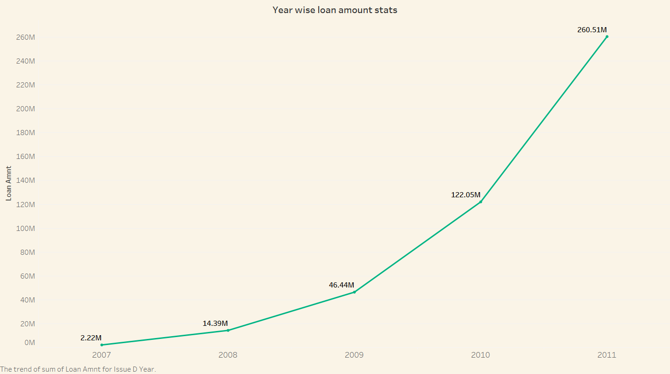
1. Year wise loan amount Stats
The Loan amount is directly proportional with the increasing years.
It is continuously increasing by each year as you see it‘s varies from 2.22M to 260.51M between the years 2007 to 2011.
From the year 2009, The changes in loan amount is suddenly increased with a higher rate that is around 5 times higher rate for next 2 years as compared to previous 2 years.

Slide 6
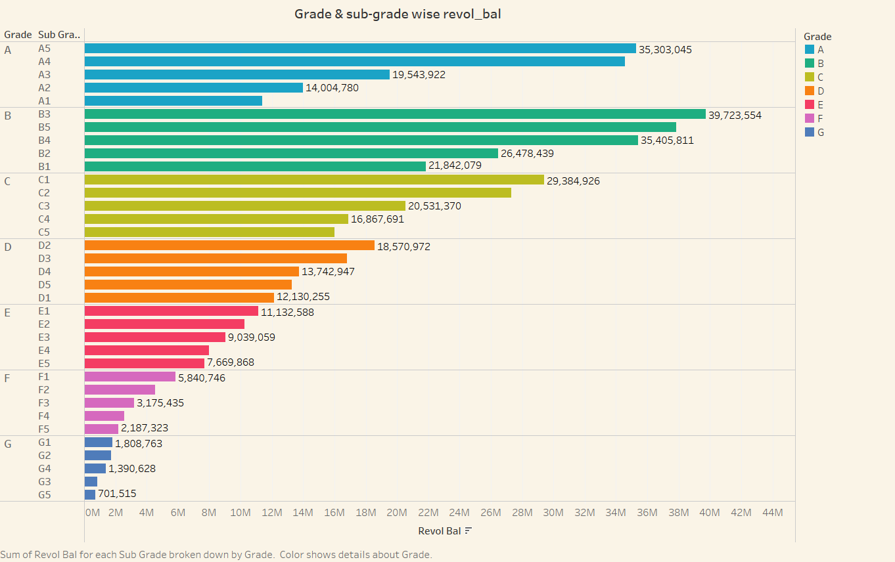
2. Grade & Sub-Grade wise revolving balance
There are 7 main grades and it‘s further consists of 5 sub-grades, It is sown by different colours in the representation from grade A to G.
The average revolving balance is higher in the ‘grade B’ its around 29M and the maximum reaches in the ‘sub-grade B1’ that is 39M, Same like the average lower revolving balance is in ‘grade G’ its around 1200K and the minimum reaches in the ‘sub-grade G5’ that is 701k.

Slide 7
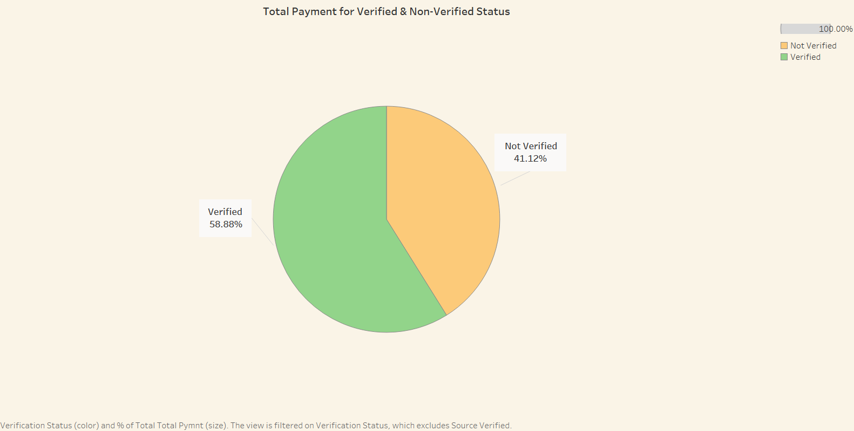
3. Total Payment for Verified & Non-Verified Status
The total payment for verified account is higher as compared to non-verified.
There are 58.88% verified accounts and remaining 41.12% are non-verified.

Slide 8
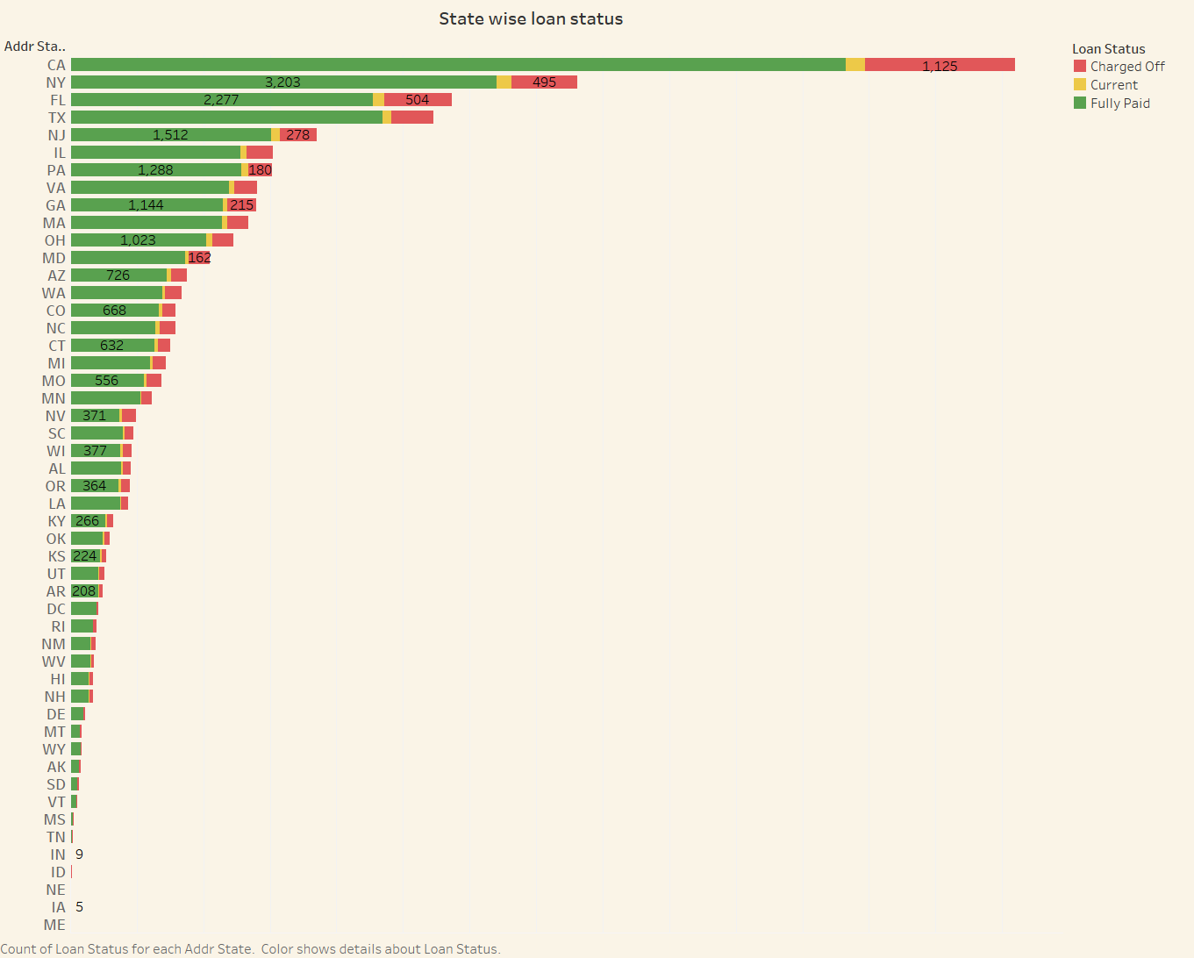
4. State wise loan status
In the dataset we have 50 state, along with the 3 type of loan status. That is changed off, current and fully paid.
As you see from the representation, State ‘CA’ has the highest number of accounts in each type of lone status specially fully paid accounts. And state ‘ME’ has the lowest number of accounts in each type of lone status.

Slide 9
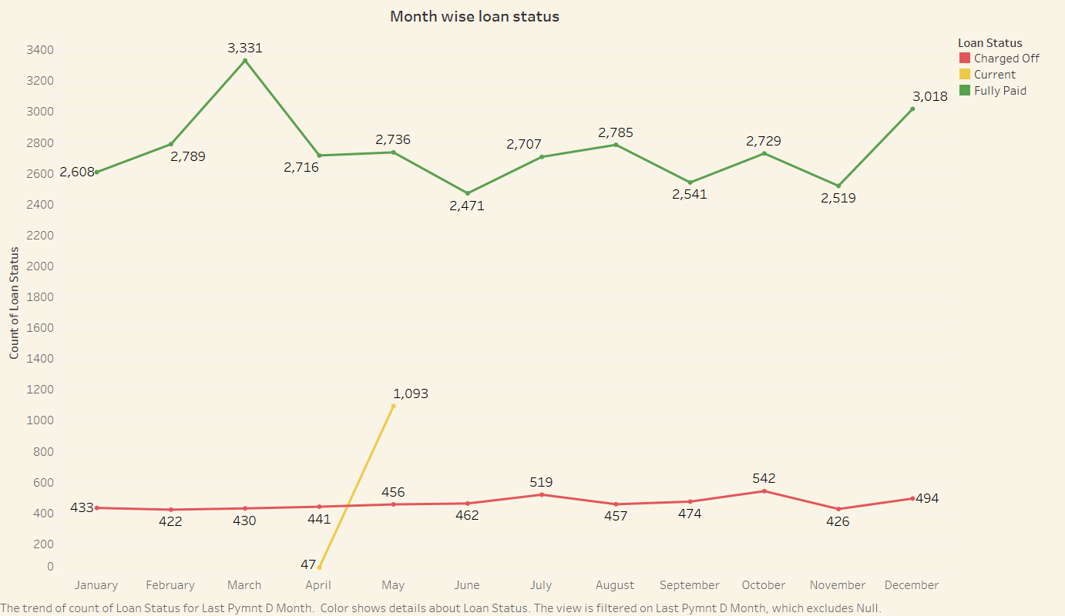
5. Month wise loan status
In the representation, Different colours of line shows the 3 type of lone status between the 12 months. That is red line indicates the changed off, yellow line indicates the current and green line indicates the fully paid.
As you see the highest number of fully paid accounts is in the month of ‘March’ that is 3331 and lowest is in the month of ‘September’.
Same like this we can easily find the variations of number of accounts for other 2 type of loan status with the month wise.

Slide 10
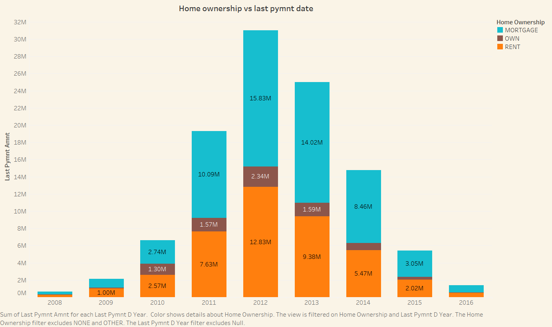
6. Home ownership Vs last payment date stats
Home ownership consists of the 3 types that is mortgage, own and rent indicted by different colours blue, brown and orange respectively.
In the bar plot of representation, The type of amount of Home ownership varies from 2008 to 2016. And the maximum amount reaches in year 2012, That is around 31M. And the minimum amount is in 2008.

Slide 11
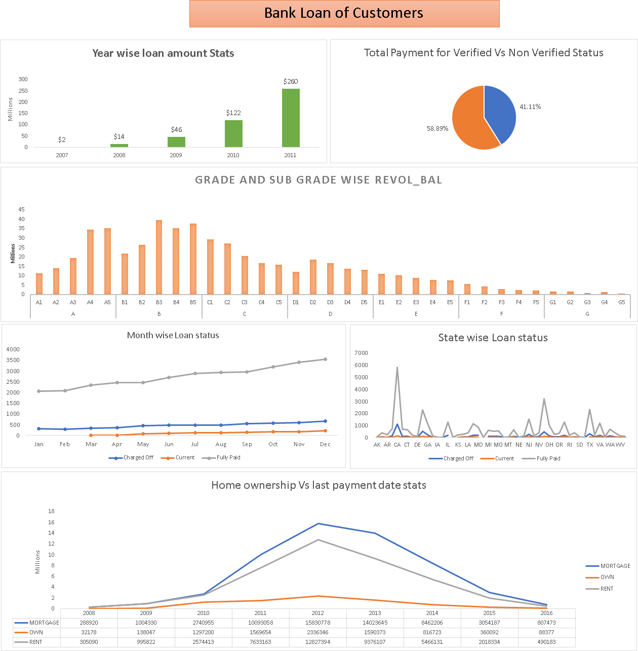
Bank Loan Dashboard

Slide 12
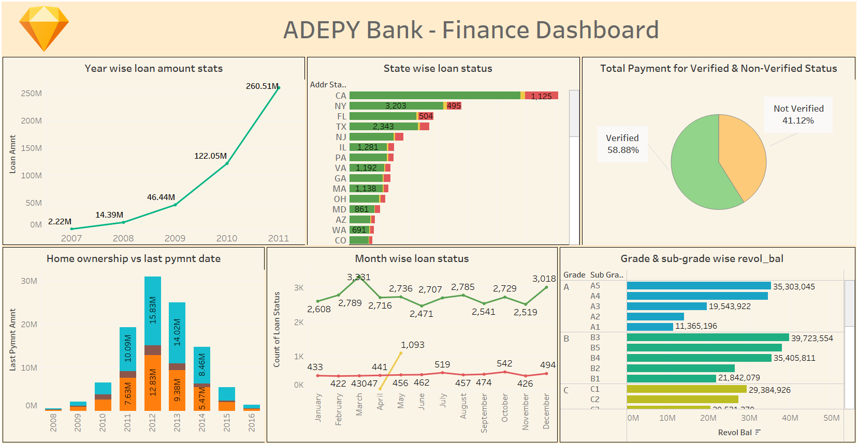
Bank Loan Dashboard

Slide 13
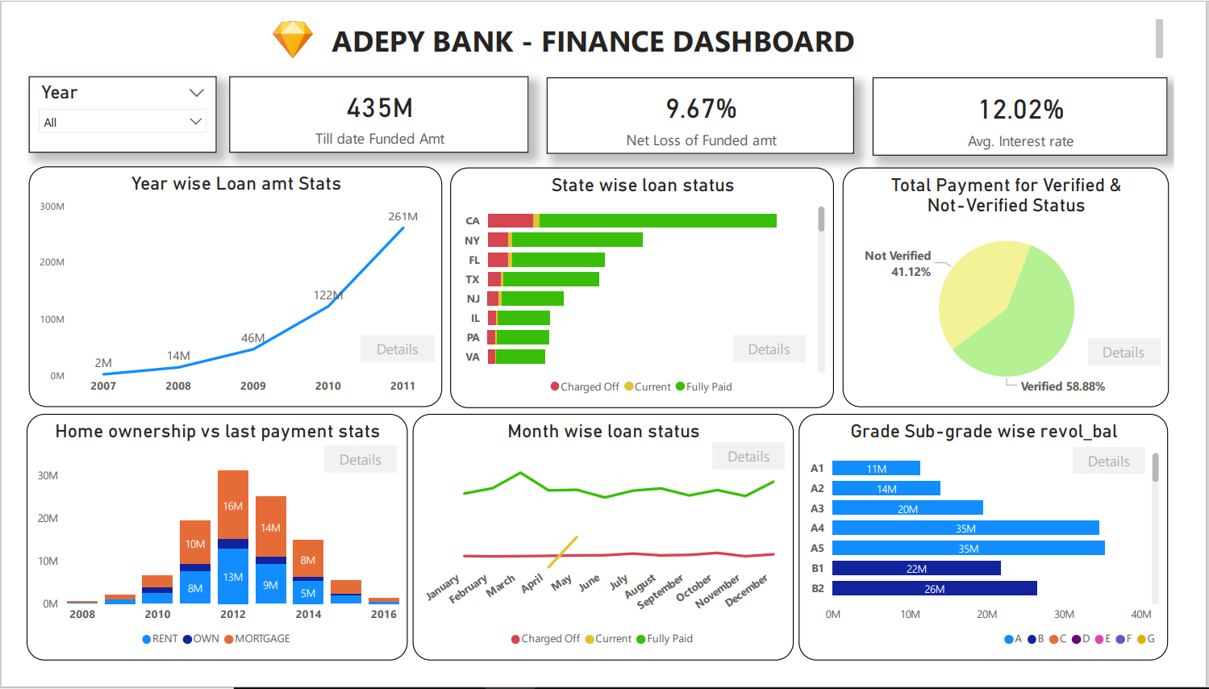
Bank Loan Dashboard

Slide 14
Conclusion
From the analysis of above dashboards and reports we can draw hidden insights. With the use of gained insights from the given KPI’s of finance dataset, Accurate business decisions are made and can track the business state.

Slide 15
Thank You !

